Slide 1
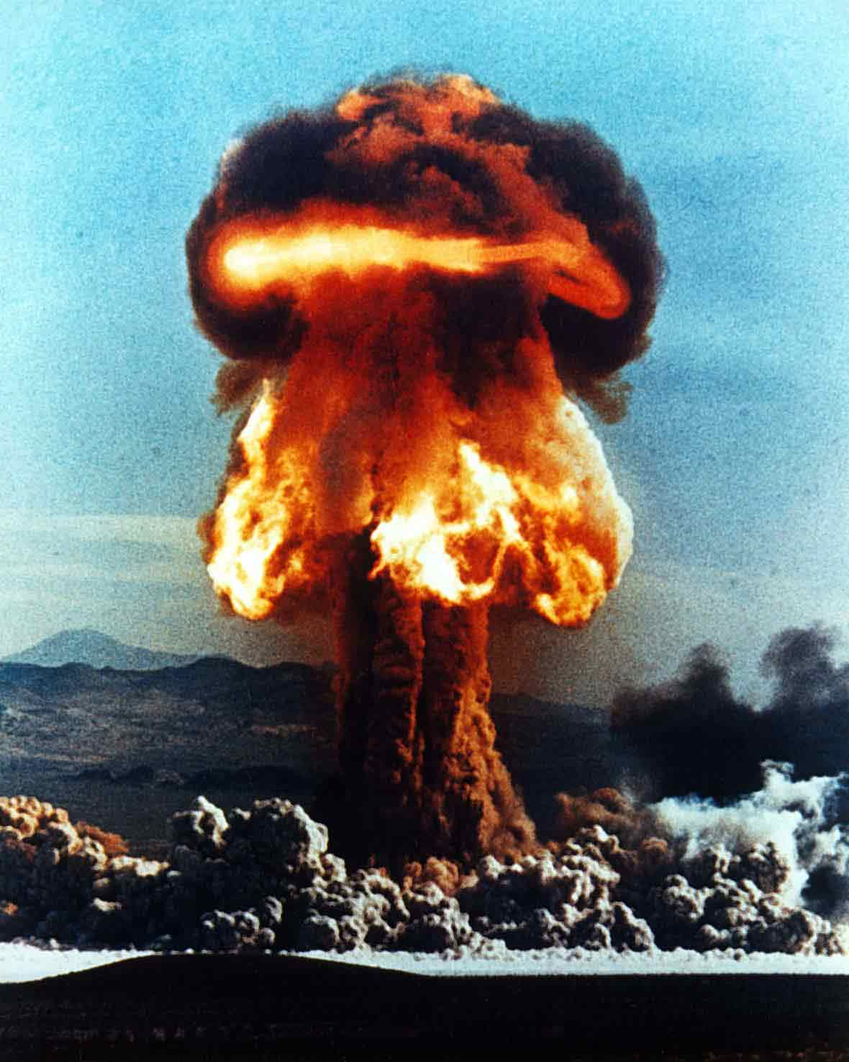
Backup, Replication DR &Business Continuity
By James Kilby @Jameskilbynet
Notes:
Welcome to VMUG
Thank you all coming
Thank Steve and Nathan
Introduce me…

Slide 2
A little about me….
Working with VMware since early 2008 ESX(i) 3.5
Currently work as a Service Design Engineer for Adept4, UK based managed service provider
Manage an estate of approx. 80 Hosts split across 4 DC’s and customer sites serving global companies.
Run mini data centre at home ☺

Slide 3
Intro:
Reasons for talking about backups etc
The FIRST questions you need to ask
The non technical bits
Be aware of……
Have you thought it through ??
No really have you thought it through ?
What are you reliant on ?
Some of the tech
Why Veeam ?
Backup & Replication
Backup Copy
Multi DC Design
Can you restore ?
Testing & Veeam Virtual Lab
Notes:
Hands up backup important
Backups aren’t sexy
Last on the list
Insurance policy. DR is less sexy less resepcted by Business ? Do they ever let you test ???

Slide 4
The FIRST Question’s
What are my Recovery Point Objectives ? (RPO)
What are my Recovery Time Objectives ? (RTO)
In both cases these need to be defined by the business they are not IT questions!!
Notes:
We are all techys we love playing with the toys
What does the Business need and what will it pay for ?
Sit down with the data or app owners what do they want

Slide 5
What can go wrong ??
But did you think of ?
Sabotage ( internal )
Inadvertent typo’s
Firmware error’s
Documentation Error
Fire
Flood
Earthquake
Hurricane
Terrorism
Winter storms
Let Hani use the projector
Notes:
Many reasons backups or DR
Where do you store your documents ? Sharepoint Dropbox. File server
Your head ?
How do you access your DC approved list and email ??
The column on the right is much more likely to lead to an outage
DR runbook what and who can trigger. Documented pre approved
Do you automate failover ??
SRM Zerto
Document typo

Slide 6
People
Process
Technology
We Can only usually sort the 3rd aspect……….
Notes:
In all of the above you are limited by those 3 aspects.
Help develop the top 2
Moving onto somrthing a little more technical

Slide 7
What are you reliant on ???
Internet Service Provider
Public DNS
Data Centre’s
Domains ?
Notes:
Moving on to things you can control the above you just need to mitigate….
All of the aboves key suppliers…..
You may rely on something that relies on something lthat relies on something like Amazon
Moving on to stuff you can control
Whats your DC like we all want it like

Slide 8
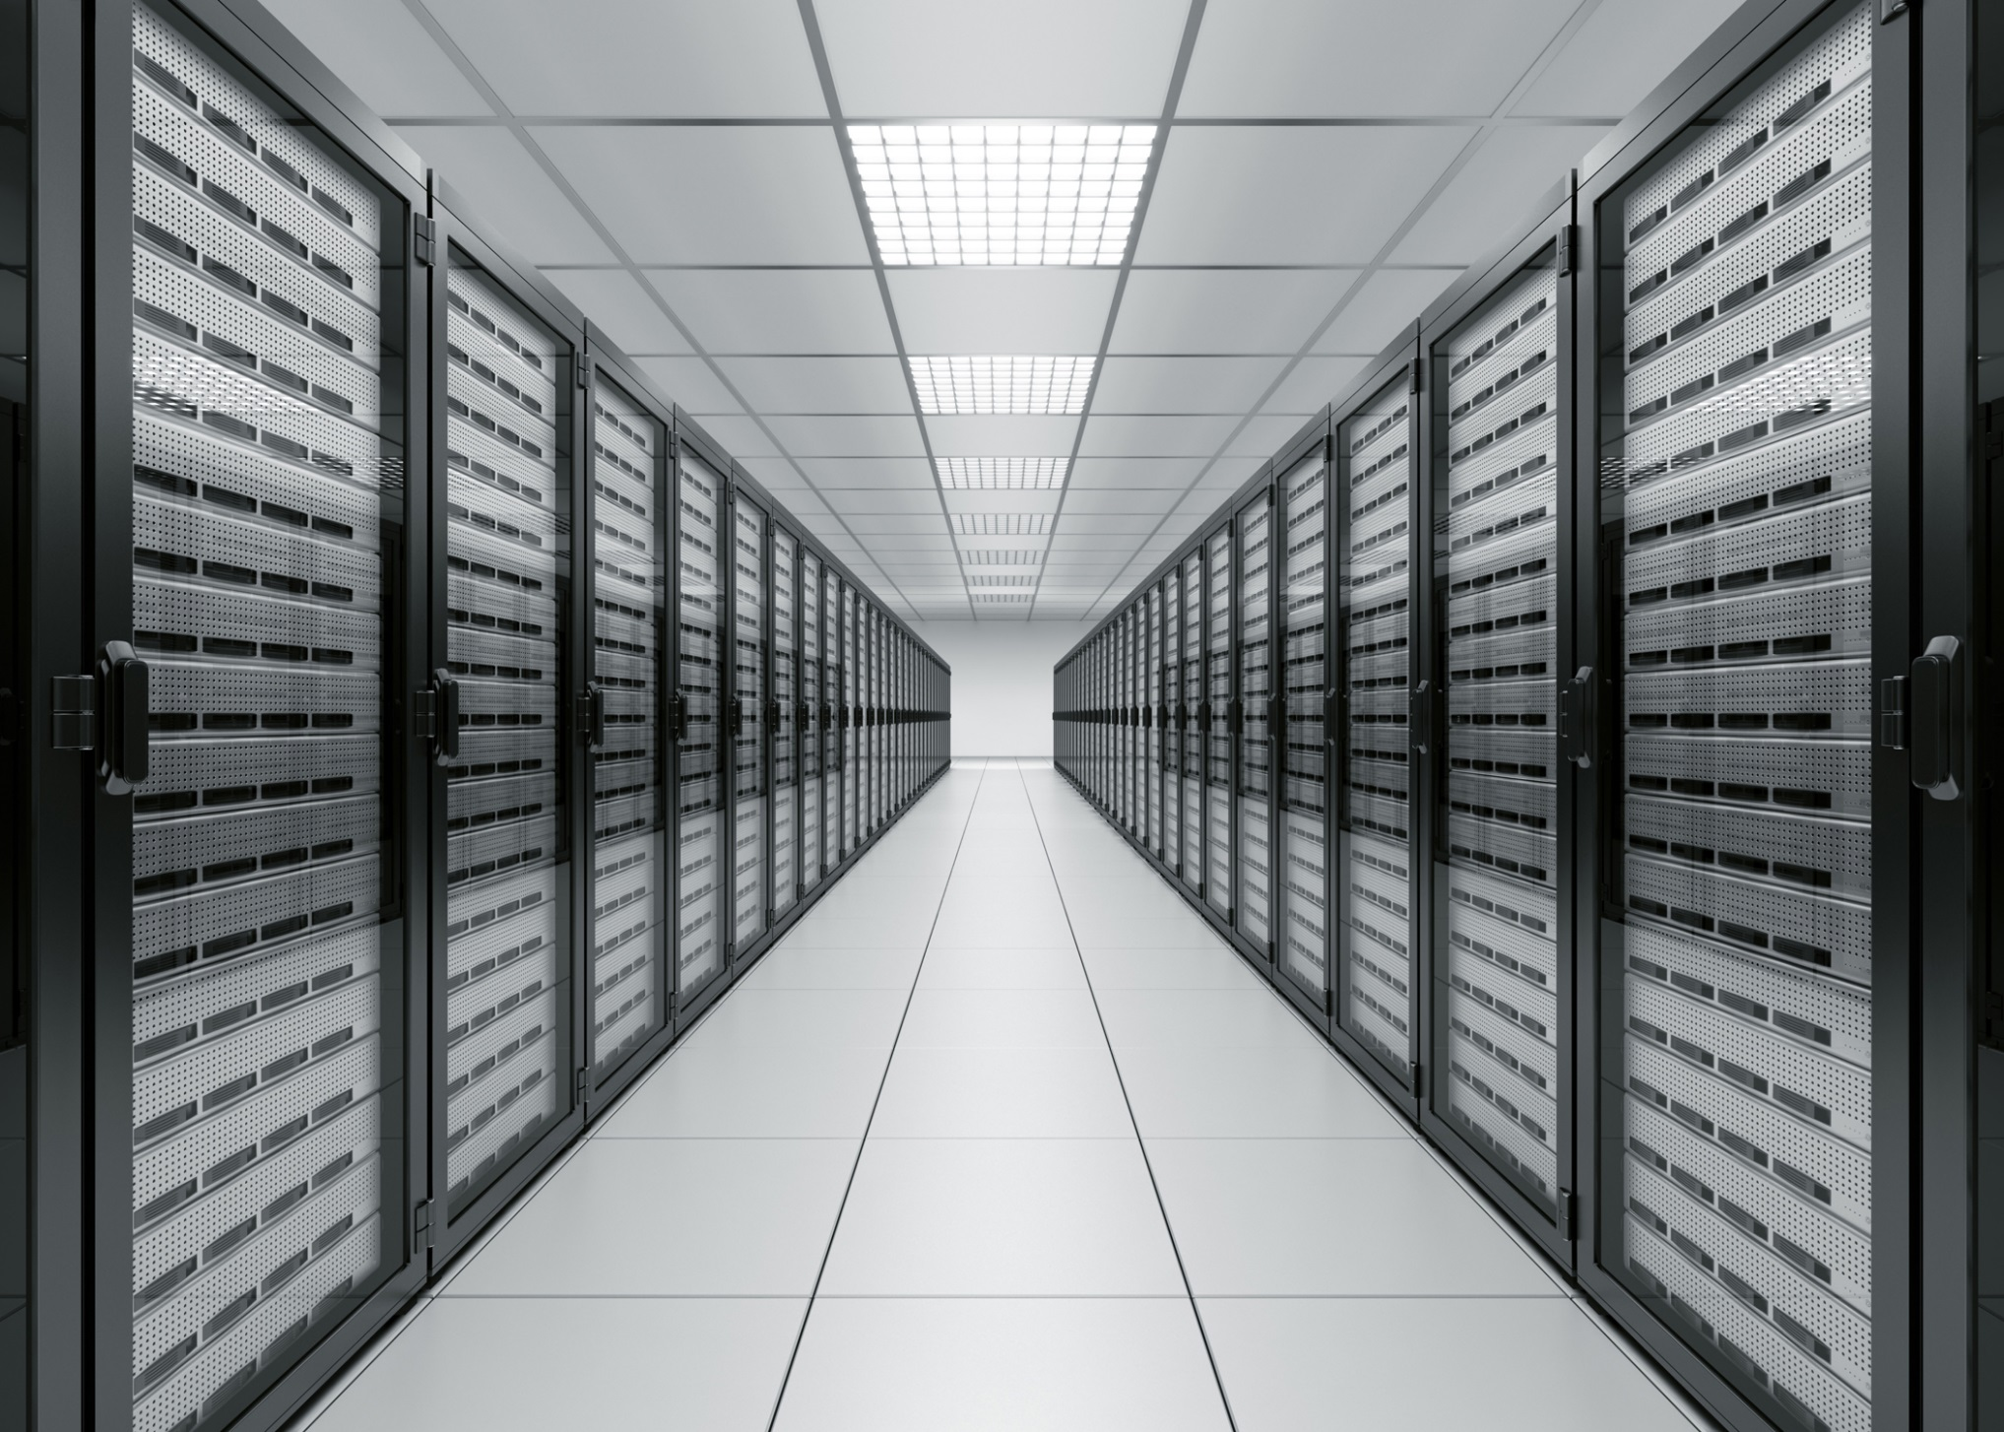
Notes:
Hands up

Slide 9
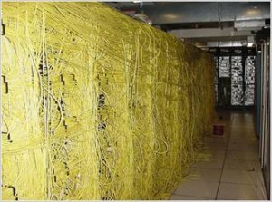
Notes:
Even if it was you wouldn’t put your hand up….
Fully functional but….

Slide 10
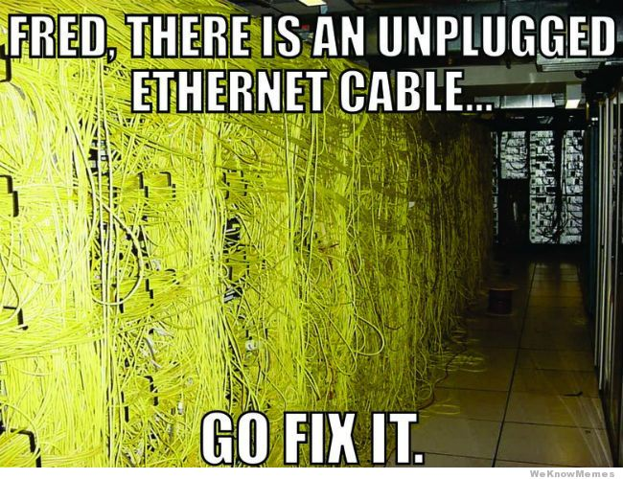
Notes:
Invoke Dr
Not meet business SLA
Prevention is better than cure
Cant stop floods. Don’t put your datacentre on a flood plain. ( new York hurricane sandy )
Little bit off topic non tech questions when planning. Ensure the backups DR and BC are in your design from day 1 not an after thought when the ££ has gone

Slide 11
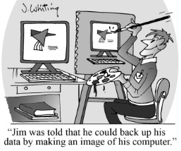
Backup Software options
Veeam
VMware Data Recovery
Backup Exec
Microsoft DPM
Acronis
Commvault
Windows Server Backup
Let the users do it
Mix and match
Take a brave pill ?
Notes:
RGE
Resume generating event none of us want that bunch friendly people
WAF- wife acceptance factor homelab

Slide 12
Why Veeam ?
It Just works :p
Good feature set ( improving all the time)
Image based backup.
Support is good
Backups and restores fast ( designed correctly )
Ability to test backups
Notes:
V8 now out with tons of new features

Slide 13
Backup feature set:
Snapshot based backup
Storage integrated HP VSA and Netapp ( Backup from storage snapshots)
Supports another Hypervisor ( if you needed to)
Various explorers for Exchange, SQL, Sharepoint AD etc
Agentless
Fast backups give the Veeam Proxy direct access to storage iscsi/FC ( Restores all still done through the VMware stack) v7
Notes:
Test restore performance
( no persistant agents)
More to come…
Reverse incremental and forward. Discuss differences
V8 can do through iscsi thick provisioned only

Slide 14
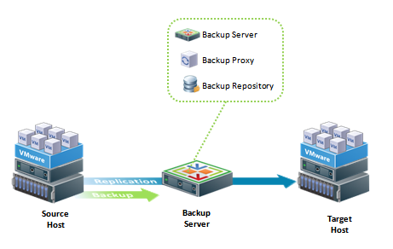
As per backups but data is stored in Hypervisor environment ie Host to Host
Useful to DR server to alternative site ( IP Change)
Alternative host in current site
Notes:
Replication. Uses more storage RTO is machine boot time

Slide 15
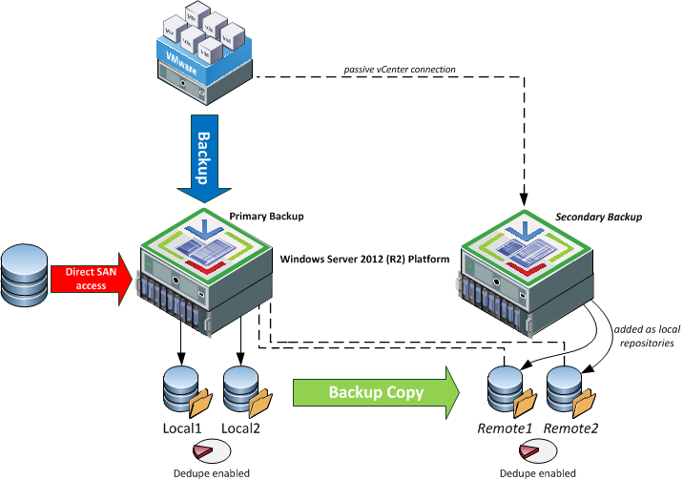
Backup Copy
Notes:
One of the most useful features of Veeam local backup for quick restore
Offsite for best protection only reads production data once
Size can be an issue. Destination should be dedupe aware data domain. 2012R2 or nimble

Slide 16
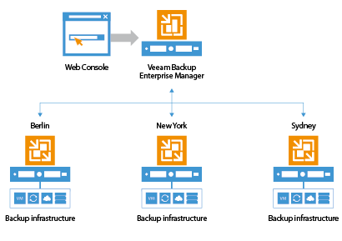
Notes:
MGMT server can manage other sites. Backups are fine restores of vmdk’s are fine. Guess can be an issue performance ( wan speed latency no of files etc)

Slide 17
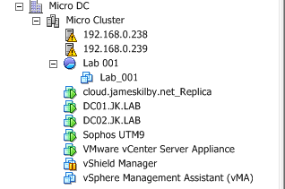
Are you sure they work ? Veeam Sure backup
One of the best and least used features.
Notes:
Describe deployment and sure backup
Create nfs share from Veeam server to Vmware and boot your backup
Run tests and report
LAB your prod environment test changes ahead of work

Slide 18
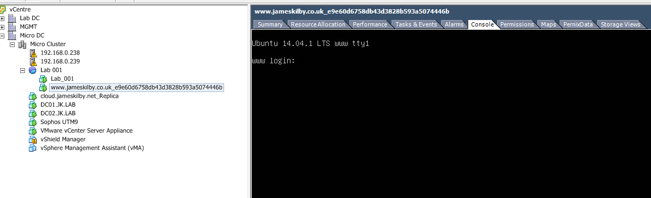

Slide 19
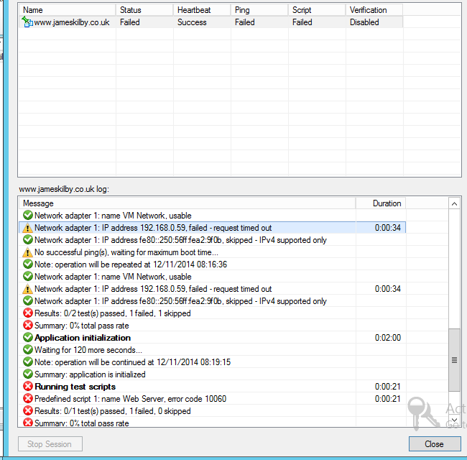
Notes:
AD DNS SQL specific databases v8 Ping
Custom scripts
Multiple vms
Anyone use this ?
All of the estate ?
Some of it

Slide 20
Infrastructure
AD DNS vCentre
Backups
Firewall
Switch
Licences
Could you rebuild your environment from scratch ?
How long would it take you ?
Notes:
Million other things required
BGP ?? MPLS
Stretched layer 2 ?
Veeam cant protect everything but it’s a good place to start

Slide 21
Gotchas !!
Current Bug in CBT VMware all versions see KB2090639
See http://goo.gl/wy2B4h thanks to Dean for a great blog on it.
Be careful with raid sets on backup infrastructure. Rebuild time with a failed disc when using large RAID sets and SATA.
IO performance of backup proxy (especially using reverse incremental)
Windows file cache- can exhaust your ram with large backup files more noticeable with reverse incremental
Notes:
Vmware not Veeam bug potentially impacting all snapshot based backups
3mb/s per spindle raid 5 sata 7200
30mb/s

Slide 22
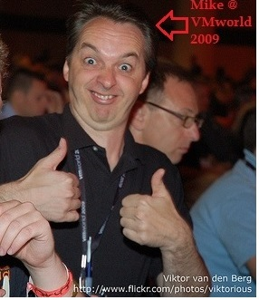
#Feed4orward
Feedforwarded Initiative championed by
Mike Laverick
This presentation reviewed by
Chris Dearden (Veeam) @ChrisDearden
http://www.vmug.com/feedforward

Slide 23
Any Questions ??

